Slide 1
Programming for Data Analytics
Programming Paradigms
Sam Weiss
sweiss@cct.ie

Slide 2
What is a Programming Paradigm?
A paradigm is a way of viewing the world
A programming paradigm is a way of viewing how to program
We’ll look at a few:
Imperative
Procedural
Functional
Declarative
Object Oriented

Slide 3
Imperative Programming
Imperative programming sees a program as a series of steps/instruction to be executed in order.
Most of our code so far is like this!
hours = input(“What are your hours?”)
hours = float(hours)
rate = input(“What is your rate?”)
rate = float(rate)
pay = hours*rate
print(f“Your pay is: €{pay}”)
The program executes line 1, then line 2, and so on until the program is finished.

Slide 4
Imperative Programming
Advantages:
Straight-forward
How we think about algorithms
We are familiar with it eg recipies
Disadvantages:
Can be hard to find specific parts in a big program
Code can’t be reused
Can be hard to follow
Harder to maintain or make changes to

Slide 5
Procedural Programming
Like imperative, but makes use of “procedures” or “subroutines”.
In Python, we use functions for this.
Code that is repeated can be separated from the rest of the program and can be invoked by calling the subroutine (function).
When a subroutine is called, the main program stops what it is doing, and runs the subroutine (line-by-line, imperatively) until it reaches the end of the subroutine. The main program then resumes, possibly with some changes to its state or using an output of the subroutine.

Slide 6
Procedural Programming
Example:
def calculate_pay(hours, rate):
if hours <= 40:
return hours*rate
else:
return (hours-40)*rate*1.5 + 40*rate
hours = float(“What are your hours?”)
rate = float(“What is your rate?”)
print(f“Your pay is: €{calculate_pay(hours, rate)}”)

Slide 7
Procedural Programming
Advantages:
Allows code to be reused (subroutines can be called more than once!)
Can make the program more readable
Can make the program easier to maintain (a change to a subroutine only needs to be made in one place!)
Disadvantages:
Changing the state of the program in a subroutine can make it harder to debug the program

Slide 8
Functional Programming
Functional programming considers functions to be “first-class citizens”
As much as possible is done via functions
Functions can be assigned to variables
Functions can be function inputs
Function can be function outputs
Emphasis is on “pure” functions – functions which only depend on their inputs, and do not otherwise alter the state of the program

Slide 9
Functional Programming
Example:
def getUserInput():
hours = float(“What are your hours?”)
rate = float(“What is your rate?”)
return hours, rate
def calculate_pay(hours, rate):
if hours <= 40:
return hours*rate
else:
return (hours-40)*rate*1.5 + 40*rate
def printPay(pay):
print(f“Your pay is: €{pay}”)
hours, rate = getUserInput()
pay = calculatePay(hours, rate)
printPay(pay)

Slide 10
Functional Programming
Advantages:
Main program logic can be quite readable
If done well, can make the main logic “declarative”
Functions don’t generally alter program state, making it easier to debug
Most code is reusable
Can be a good way to think about a problem
Disadvantages:
Can have more resource usage, since it relies a lot on copying instead of changing data structures
Might not be the best way to think about a problem

Slide 11
Declarative Programming
Declarative programming specifies the goal of you want the program to do, rather than the instructions to do it
The main logic of the last example is a good example of this:
hours, rate = getUserInput()
pay = calculatePay(hours, rate)
printPay(pay)

Slide 12
Declarative Programming
Advantages:
Focus is on the logic and goals of the program, not the implementation details
Very readable
Easy to find logic errors
Disadvantages:
Normally can’t change the implementation details
May not know the implementation details!!
Errors in the implementation may be hard to debug

Slide 13
Object Oriented Programming
Object Oriented programming conceptualises a system as a collection of objects (built from classes) that communicate with each other
These can be physical, like people
These can be non-physical, like a restaurant booking
These can be intangible software things, like a DataFrame
Basic on four “Pillars”
Encapsulation
All data about an object stays with an object, and the object controls access
Eg a Square gets to decide when/if its side length can be read or changed
Abstraction
Features and functions in common can be abstracted to a more general class
Eg a Square and a Circle both have an area, so that can be abstracted away
Inheritance
Can have a hierarchy of objects that inherit features and functions, whilst extending them with their own
A Square can be a Shape, with its own square-specific things
Polymorphism
Objects can be treated as different kinds of objects eg a A Square can be treated as a Shape

Slide 14
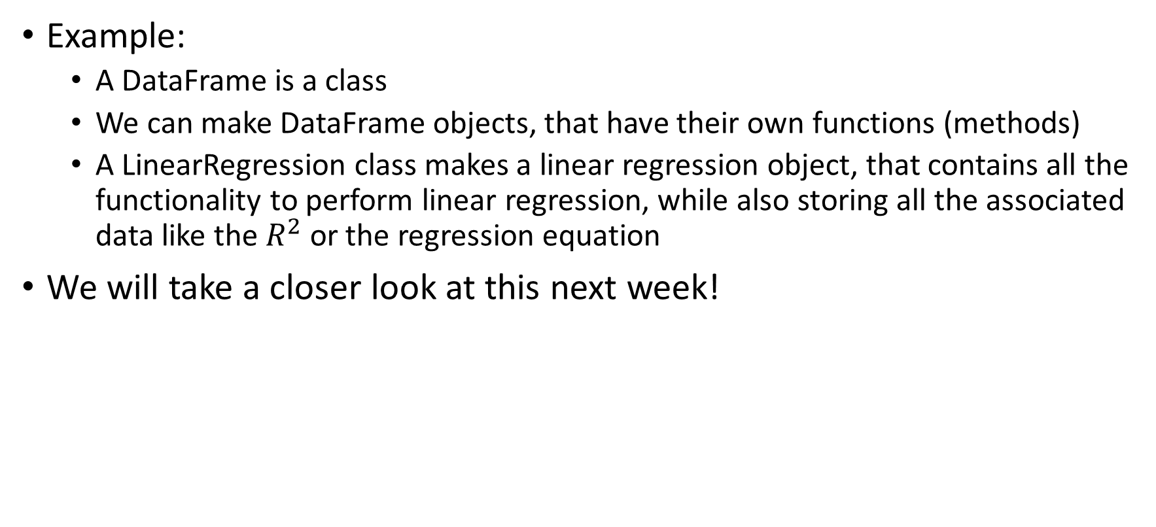
Object Oriented Programming
Example:
A DataFrame is a class
We can make DataFrame objects, that have their own functions (methods)
A LinearRegression class makes a linear regression object, that contains all the functionality to perform linear regression, while also storing all the associated data like the $R^{2}$ or the regression equation
We will take a closer look at this next week!

Slide 15
Object Oriented Programming
Advantages:
All the data about an object is kept with an object
Allows for code modularity and reusability
Can be a good way of conceptualising a problem
Can be good for collaborative software development
Disadvantages:
Can take longer to program
May not have a lot of extra benefit for Data Analytics unless you are doing something novel (all the object-orientation is already done for us!)

